Slide 1


WIRELESS DIGITAL CIRCULAR
BHARATH M VIKASH A MUKILESH J S

Slide 2

PROBLEM STATEMENT
Developing a smart circular system for educational institutions that allows speakers to upload content to a Telegram bot and have it read aloud in specified classrooms using Raspberry Pi devices.

Slide 3

EXISTING SOLUTION
In our institution information is passed in the way of text which needs to be carried out by a person and there is a need for a verification sign from the respective authorities to ensure that the information has been passed.

Slide 4
PROBLEMS IN EXISTING SOLUTION
1
4
Inconsistencies in Message
Deliveries
Delay in Communication
2
5
Difficulty in Managing
Updates
Risk of Information Loss
3
6
Difficulty in Tracking
Resource Intensive

Slide 5
PROPOSED IDEA
The proposed methodology introduces a new way of sending circulars by text and converting them into a voice for conveying information. They can ensure that the information has been passed successfully by viewing the acknowledgment from the telegram application. This is a useful method of conveying information which is a time-saving one.

Slide 6

BLOCK DIAGRAM
RPI
(TTS Conversion)
Relay Switch
(4 way)
Audio
Amplifier
RECEIVER UNIT
Speaker
1
Speaker
2
Speaker
3
Telegram
Application
(API key)
SENDER

Slide 7
NOVELTY
Automatic process of process distribution
Real-time notification
Customization and Flexibility in Selecting Classroom
Less manpower
Fast circular transfer

Slide 8
Technology Implemented
Text-to-speech conversion
Python programming language
VNC viewer
TTS conversion using the telegram application

Slide 9
Mechanism behind text-to-speech converter
OCR – Optical Character Recognition
Text
Processing
Module
(OCR)
Voice
Processing
Module
(TTS)
Text input
Text
Voice wave
speech

Slide 10
COMPARATIVE STUDY
OPERATION | MANUAL CIRCULAR | WIRELESS CIRCULAR
Time to covert mail into Circular/message | 1 - 2 mins | 30 – 60 sec
Time to convert the Circular/message to voice | 10 - 15 mins | 5 – 10 sec
Time to reach the Receivers/speakers | 20 – 30 mins | 10- 20 sec
Total(approx..)time | 30 – 40 mins | 45 – 90 sec

Slide 11
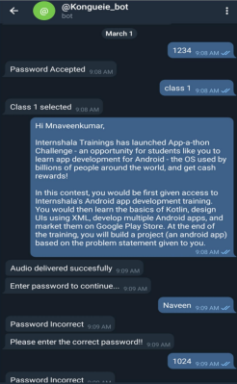
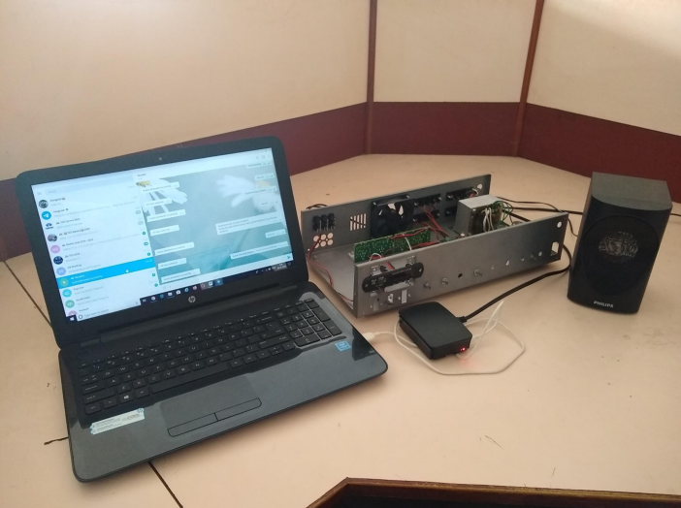
OUTPUT

Slide 12
APPLICATION
Important Announcement
Fast Circular Distribution
Emergency alert and safety information
Easy management system
Flexibility in selecting class

Slide 13
Thank you

Slide 14

QUESTIONS

